Slide 1
Sorting Algorithms
CS/IT, UCER Prayagraj

Slide 2
The Sorting Problem
Input:
A sequence of n numbers a₁, a₂, . . . , a_{n}
Output:
A permutation (reordering) a₁’, a₂’, . . . , a_{n}’ of the input sequence such that a₁’ ≤ a₂’ ≤ · · · ≤ a_{n}’
1
Notes:
<number>

Slide 3
Some Definitions
Internal Sort
The data to be sorted is all stored in the computer’s main memory.
External Sort
Some of the data to be sorted might be stored in some external, slower, device.
In Place Sort
The amount of extra space required to sort the data is constant with the input size.
1
Notes:
<number>

Slide 4
Insertion Sort
Idea: like sorting a hand of playing cards
It uses incremental approach.
It is Stable Sorting.
e.g Before sorting 3#, 3*,5,1 after sorting 1, 3#, 3* ,5
Start with an empty left hand and the cards facing down on the table.
Remove one card at a time from the table, and insert it into the correct position in the left hand
compare it with each of the cards already in the hand, from right to left
4
Notes:
<number>

Slide 5
Insertion Sort
To insert 12, we need to make room for it by moving first 36 and then 24.
6
10
24
36
12
5
Notes:
<number>

Slide 6
Insertion Sort
6
10
24
36
12
6
Notes:
<number>

Slide 7
Insertion Sort
6
10
24
36
12
7
Notes:
<number>

Slide 8
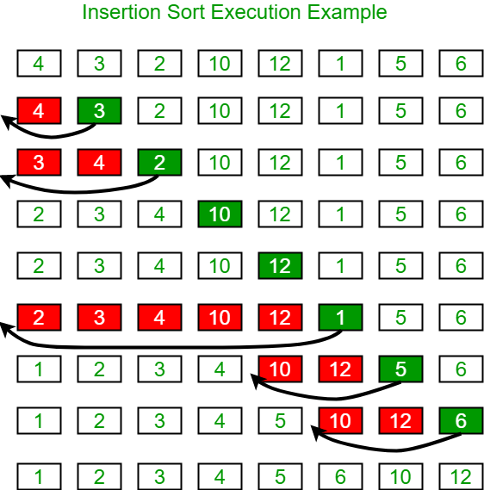
Insertion Sort
Ex. Sort the following elements by insertion sort:- 4, 3, 2, 10, 12, 1, 5, 6.
Notes:
<number>

Slide 9
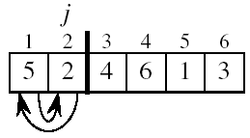
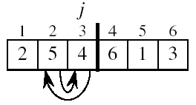
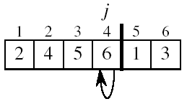
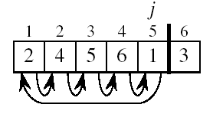
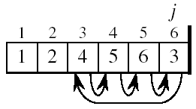
Insertion Sort
8
Notes:
<number>

Slide 10
INSERTION-SORT
Alg.: INSERTION-SORT(A)
for j ← 2 to n
do key ← A[ j ]
i ← j - 1
while i > 0 and A[i] > key
do A[i + 1] ← A[i]
i ← i – 1
A[i + 1] ← key
Insertion sort – sorts the elements in place
1
2
3
4
5
6
7
8
a₁
a₂
a₃
a₄
a₅
a₆
a₇
a₈
key
8
Notes:
<number>

Slide 11
Analysis of Insertion Sort
INSERTION-SORT(A)
for j ← 2 to n
do key ← A[ j ]
Insert A[ j ] into the sorted sequence A[1 . . j -1]
i ← j - 1
while i > 0 and A[i] > key
do A[i + 1] ← A[i]
i ← i – 1
A[i + 1] ← key
cost times
c₁ n
c₂ n-1
0 n-1
c₄ n-1
c₅
c₆
c₇
c₈ n-1
t_{j}: # of times the while statement is executed at iteration j
8
Notes:
<number>
₇

Slide 12
Best Case Analysis
The array is already sorted
A[i] ≤ key upon the first time the while loop test is run (when i = j -1)
tj=1 and
T(n) = c₁n + c₂(n -1) + c₄(n -1) + c₅(n -1) + c₈(n-1) = (c₁ + c₂ + c₄ + c₅ + c₈)n + (c₂ + c₄ + c₅ + c₈)
= an + b = Θ(n)
“while i > 0 and A[i] > key”
8
Notes:
<number>

Slide 13
Worst Case Analysis
The array is in reverse sorted order
Always A[i] > key in while loop test
Have to compare key with all elements to the left of the j-th position hence t_{j} = j
a quadratic function of n
T(n) = Θ(n²) order of growth in n²
“while i > 0 and A[i] > key”
using
we have:
8
Notes:
<number>

Slide 14
Insertion Sort - Summary
Advantages
Good running time for “almost sorted” arrays Θ(n)
Disadvantages
Θ(n²) running time in worst and average case
8
Notes:
<number>

Slide 15
Bubble Sort (Ex. 2-2, page 38)
Idea:
Repeatedly pass through the array
Swaps adjacent elements that are out of order
Easier to implement, but slower than Insertion sort
i
1
2
3
n
8
4
6
9
2
3
1
j
8
Notes:
<number>

Slide 16
Example
8
4
6
9
2
3
1
1
8
4
6
9
2
3
i = 1
j
i = 2
j
8
4
6
9
2
1
3
1
2
8
4
6
9
3
i = 1
j
i = 3
j
8
4
6
9
1
2
3
1
2
3
8
4
6
9
i = 1
j
i = 4
j
8
4
6
1
9
2
3
1
2
3
4
8
6
9
i = 1
j
i = 5
j
8
4
1
6
9
2
3
1
2
3
4
6
8
9
i = 1
j
i = 6
j
8
1
4
6
9
2
3
1
2
3
4
6
8
9
i = 1
j
i = 7
1
8
4
6
9
2
3
j
8
i = 1
j
Notes:
<number>

Slide 17
Bubble Sort
Alg.: BUBBLESORT(A)
for i ← 1 to length[A]
do for j ← length[A] downto i + 1
do if A[j] < A[j -1]
then exchange A[j] ↔ A[j-1]
i
8
4
6
9
2
3
1
i = 1
j
<number>
Notes:
<number>

Slide 18
Bubble-Sort Running Time
Alg.: BUBBLESORT(A)
for i ← 1 to length[A]
do for j ← length[A] downto i + 1
do if A[j] < A[j -1]
then exchange A[j] ↔ A[j-1]
c₁
c₂
c₃
c₄
T(n) =
c₁(n+1) +
c₂
c₃
c₄
= Θ(n) +
(c₂ + c₂ + c₄)
Thus,T(n) = Θ(n²)
<number>
Notes:
<number>

Slide 19
Selection Sort (Ex. 2.2-2, page 27)
Idea:
Find the smallest element in the array
Exchange it with the element in the first position
Find the second smallest element and exchange it with the element in the second position
Continue until the array is sorted.
<number>
Notes:
<number>

Slide 20
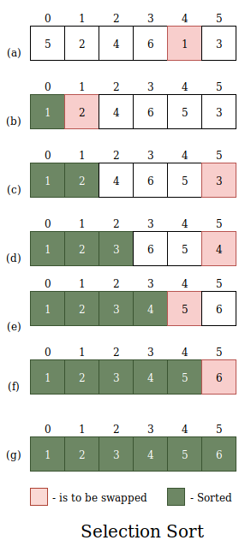
Selection Sort
Notes:
<number>

Slide 21
Selection Sort
Alg.: SELECTION-SORT(A)
n ← length[A]
for j ← 1 to n - 1
do smallest ← j
for i ← j + 1 to n
do if A[i] < A[smallest]
then smallest ← i
exchange A[j] ↔ A[smallest]
8
4
6
9
2
3
1
<number>
Notes:
<number>

Slide 22
Analysis of Selection Sort
Alg.: SELECTION-SORT(A)
n ← length[A]
for j ← 1 to n - 1
do smallest ← j
for i ← j + 1 to n
do if A[i] < A[smallest]
then smallest ← i
exchange A[j] ↔ A[smallest]
cost times
c₁ 1
c₂ n
c₃ n-1
c₄
c₅
c₆
c₇ n-1
n²/2
comparisons
n
exchanges
<number>
Notes:
<number>

Slide 23
Thanks
<number>

